Slide 1
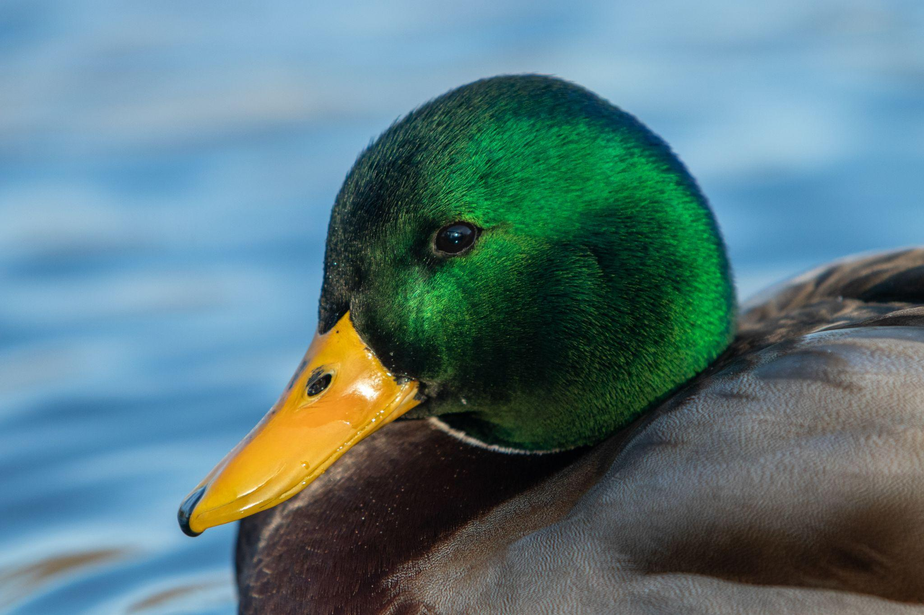
Game farms for wildfowl
What are arguments for and against farming and releasing waterfowl & (non-native) pheasants?
By Abby Thomas, Alexis LaFever, Olivia O’Hara, Conner Colesante, and Macie Brannigan
Photo obtained from Sam Denenberg

Slide 2
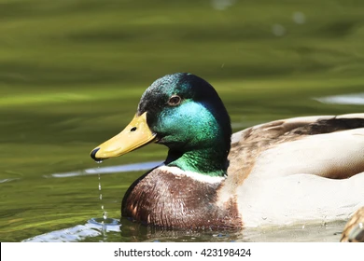
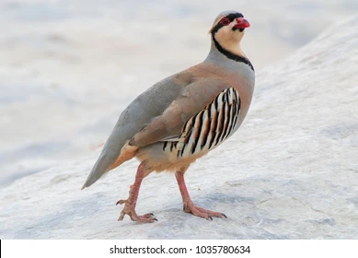
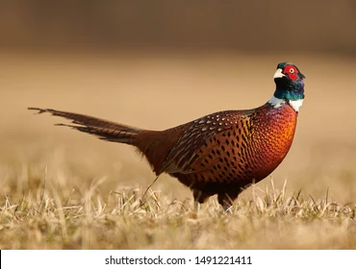
Introduction and Background
Historically game farms have raised and released mallard ducks, pheasants, chukar partridges, and other game birds.
Many states release wildfowl on public land to generate interest in hunting.
Most species of wildfowl released are not native to the United States.
The eurasian strain of mallard duck raised on game farms is genetically different than North American wild mallards and demonstrates a different phenotype (McPhaul, 2018).
There is significant evidence that released game farm mallard ducks breed with wild mallard ducks, mixing their genetics (Lavretsky et al., 2019).

Slide 3
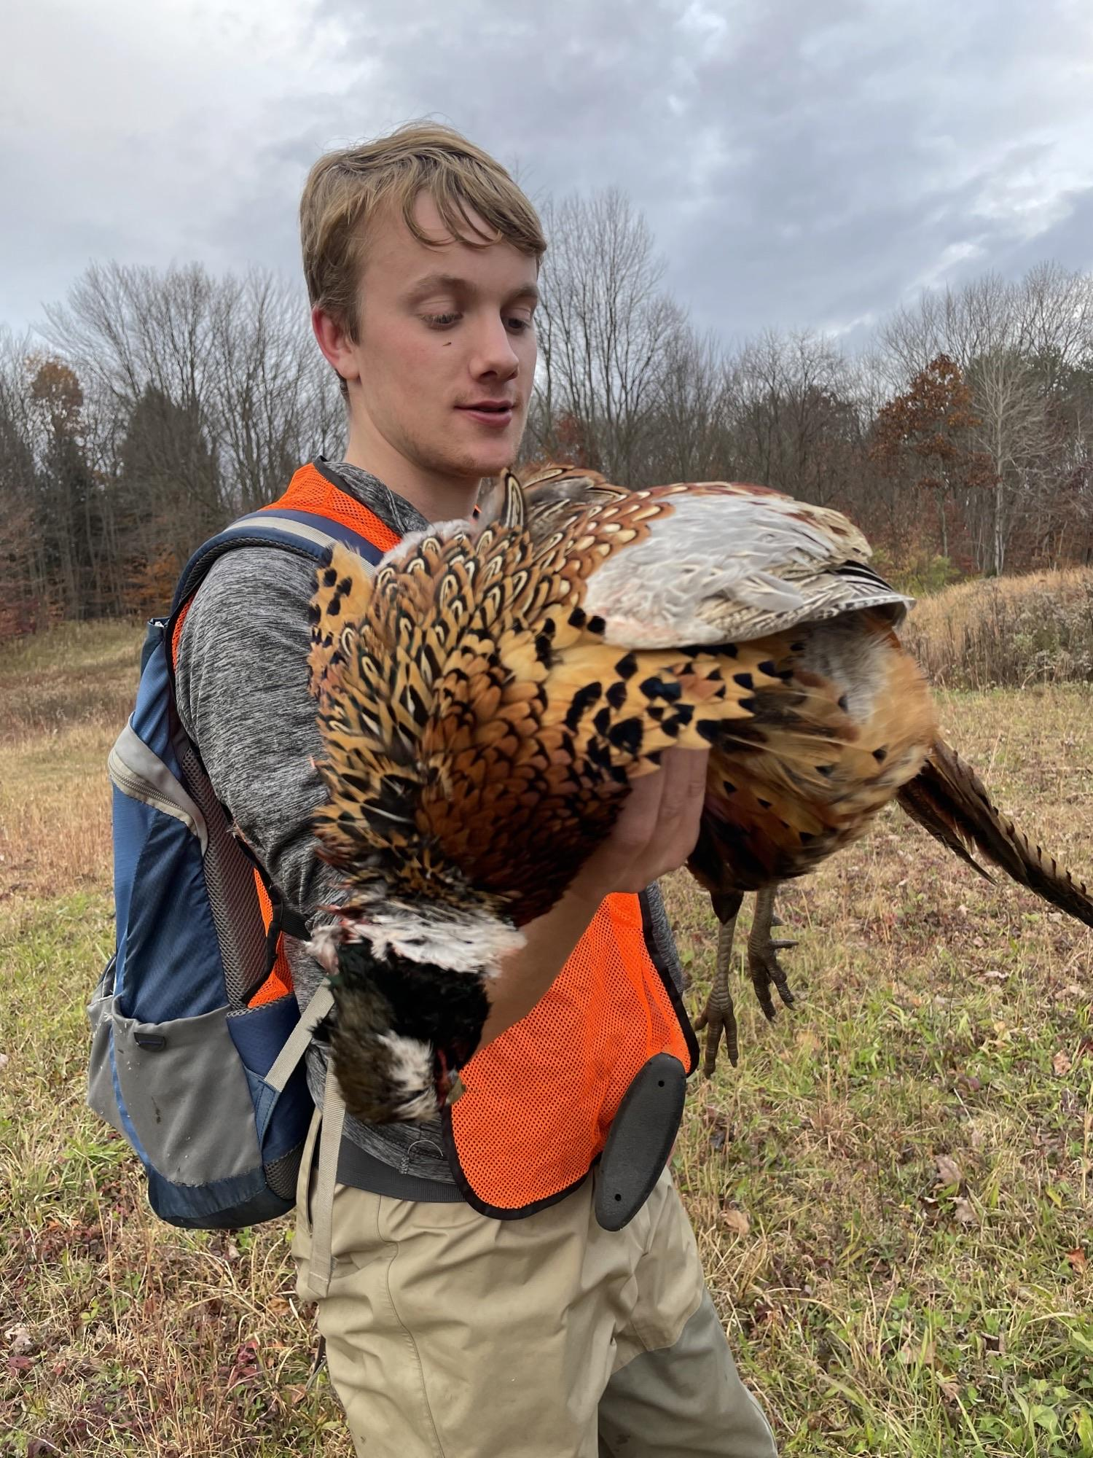
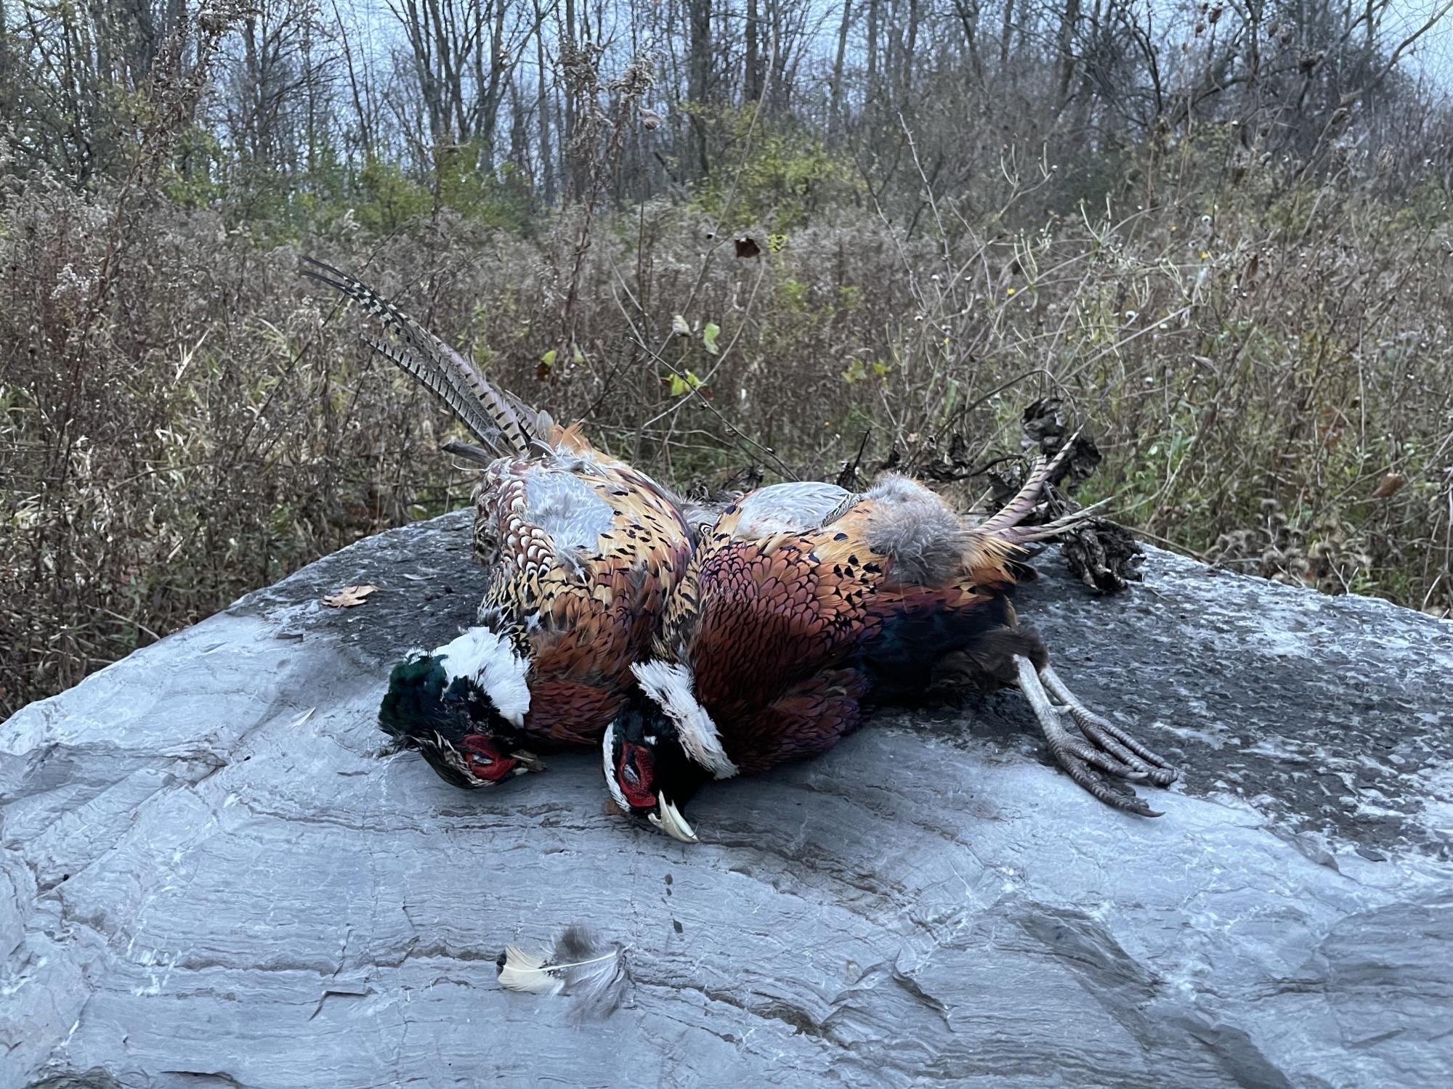
Main Points - Pros
People are encouraged to buy hunting licenses and equipment which raises money for wildlife conservation, including waterfowl
Creates jobs and keeps family run farms in business through generations
Pheasant hunting is a good way to introduce new hunters
Easy, social, don't have to get up as early
“It provides a really substantial opportunity for young hunters to be involved and get involved in hunting… As a kid I went with my father all the time and those were really good experiences for me with him and his hunting dogs and friends. It became something culturally for us for years” -Michael Schummer on the pros of game farms

Slide 4
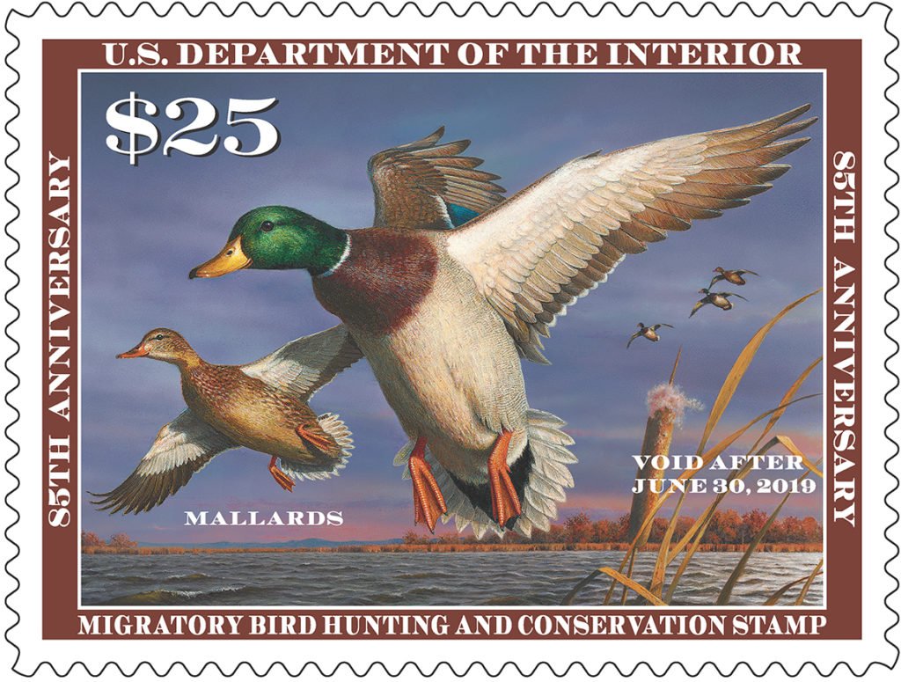
Cost Breakdown and Participation
11.5 million Americans were active hunters in 2016
2.6 million waterfowl hunters
1.9 million upland game bird hunters (pheasants are most hunted upland game bird)
$256 million spent on license, tags, and permits
$2.9 billion spent by migratory bird hunters
Over $40 million/year from duck stamp sales
Duck stamps alone-$1.1 billion towards wetland conservation/restoration (Kearns, 2021)
Obtained from Pacific Birds

Slide 5
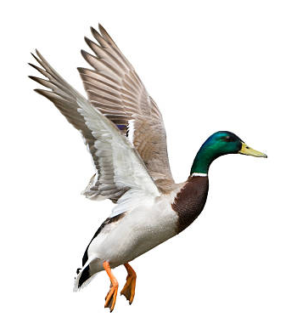
Main Points - Cons
Domestic Mallards have low survival rates due to game farm adaptations
Interbreeding between domestic and wild populations may result in wild birds with lower survival rates
Fair chase isn’t possible with pen raised birds because they are conditioned to humans, used to being fed, and have a reduced reaction to predators
Pheasants have an incredibly low survival rate and many of them are taken out by predators before hunters can access them
“Released to die”
Game farms are reservoirs of disease, which has the potential spread to wild populations once domestic birds are released for hunting
Examples: avian influenza, duck virus hepatitis, avian cholera, salmonella

Slide 6
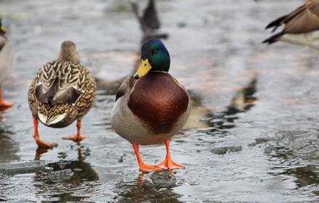
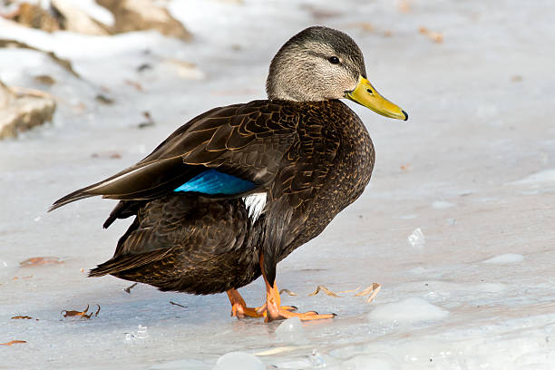
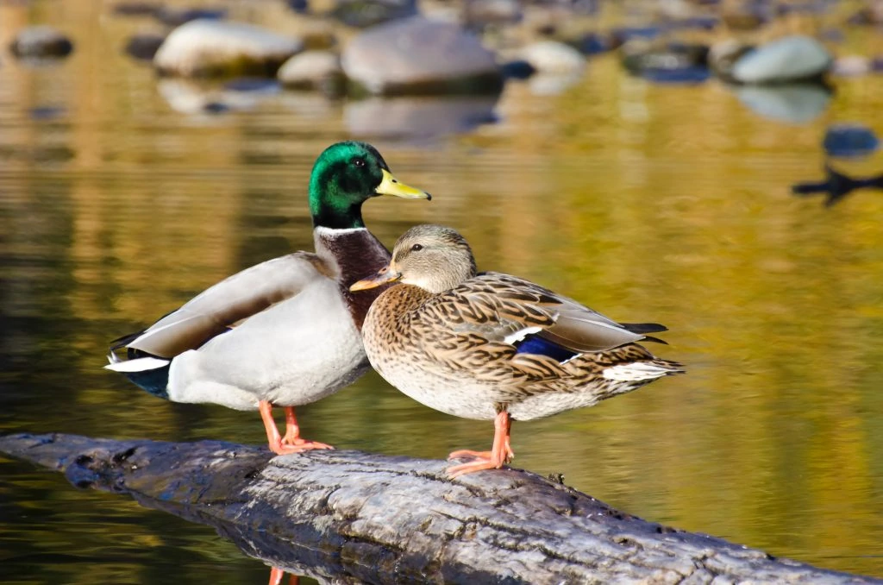
Genome
Wild Mallard
American Black Duck
Game-Farm Mallard
About 1.5% Different
About 5-10% Different
Obtained from Dr. Schummer’s Manky Mallard Presentation

Slide 7
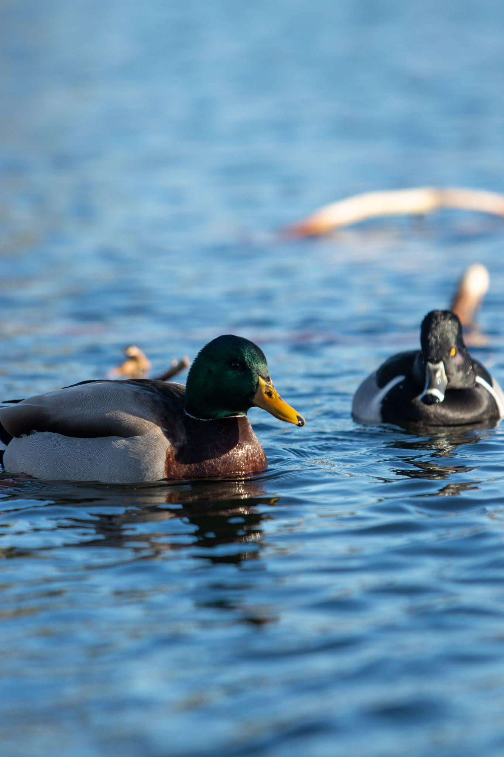
Genetics
Game farm mallards have half the genetic diversity of wild mallards
Game farm mallards differences:
300-400 grams lighter
Bills have structural differences (derived from diet)
Breeding behaviors
92% of the mallards analyzed in the Atlantic Flyway had a substantial amount of game-farm DNA
Obtained from: Ducks Unlimited, The Surprising Genetics of American Black Ducks and Mallards
Obtained from Sam Denenberg

Slide 8
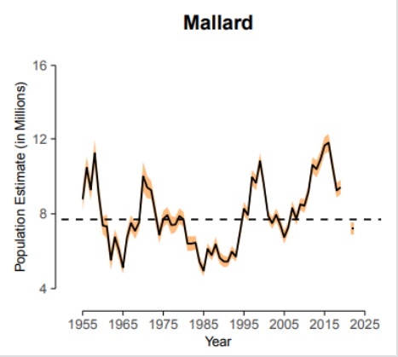
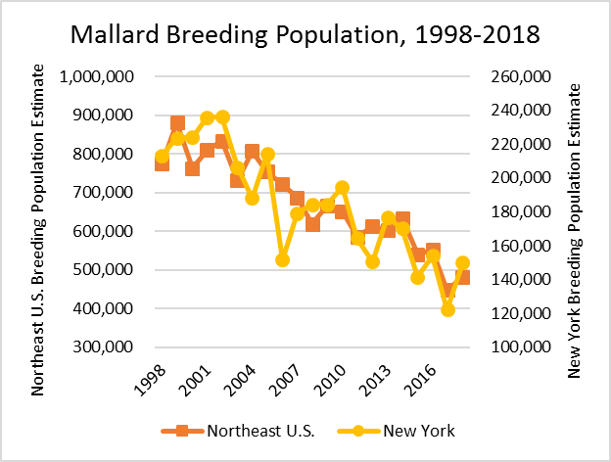
Obtained from Dr. Schummer’s Manky Mallard Presentation
NYS DEC 2018

Slide 9
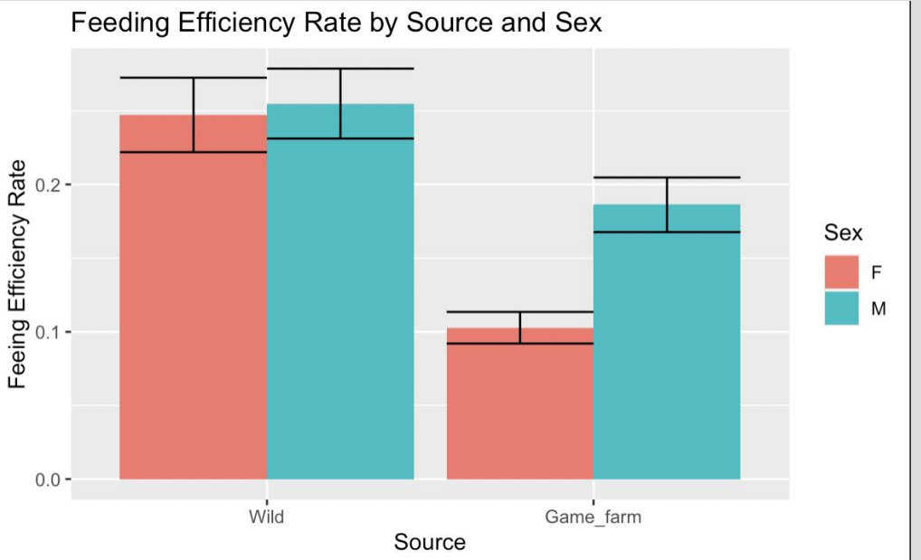
Halligan, obtained from Dr. Schummer’s Manky Mallards presentation

Slide 10
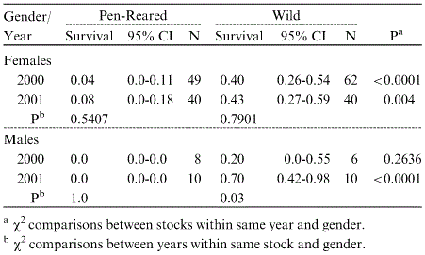
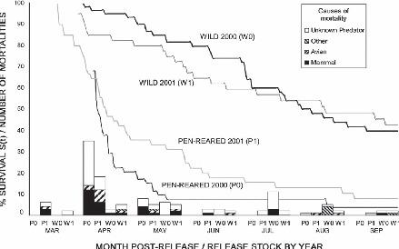
Survival of pen-reared vs wild pheasants
Pen-reared: 99% mortality by predation
Wild: 82% mortality by predation
Pre and post-predator removal in Idaho
Musil and Connelly 2009

Slide 11
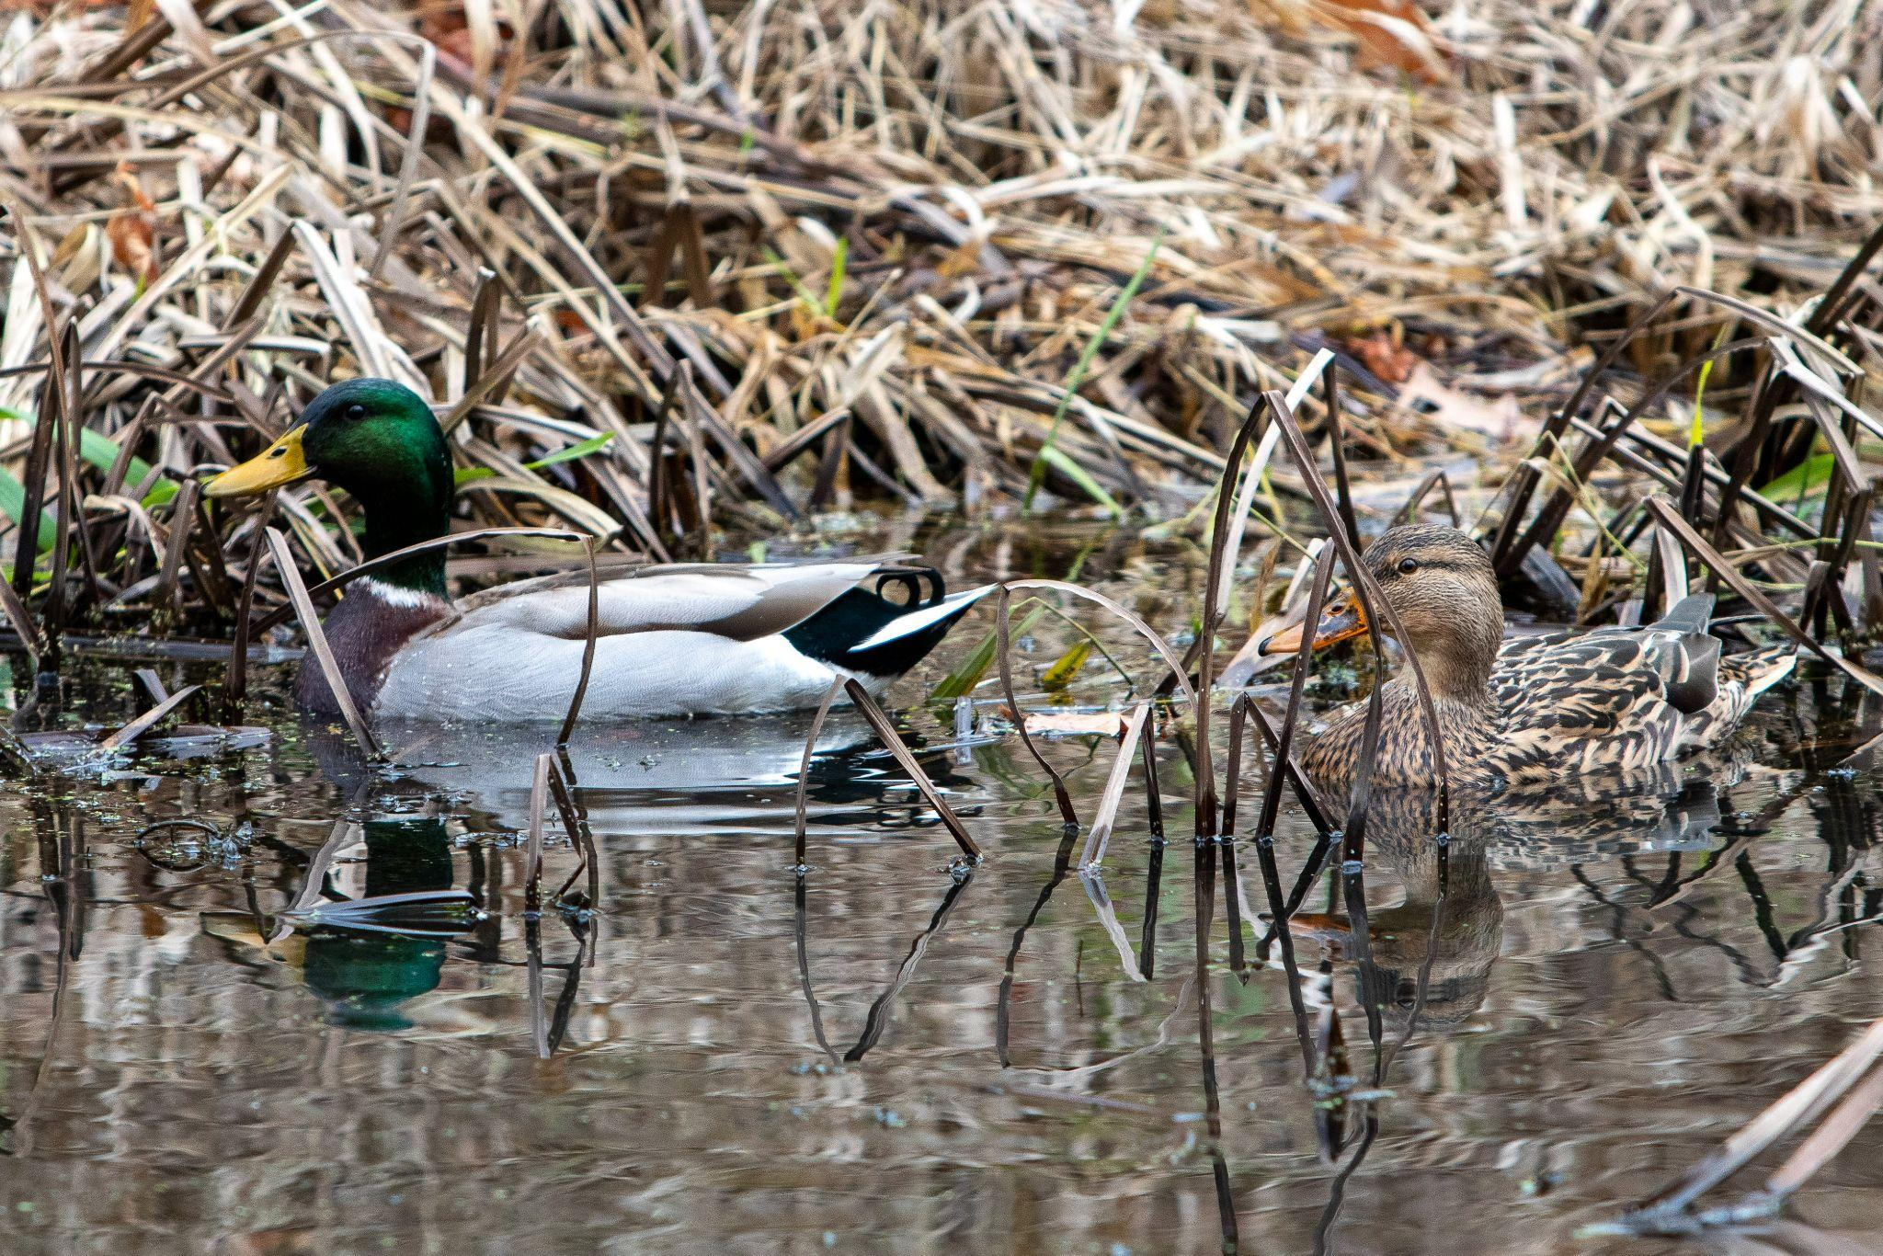
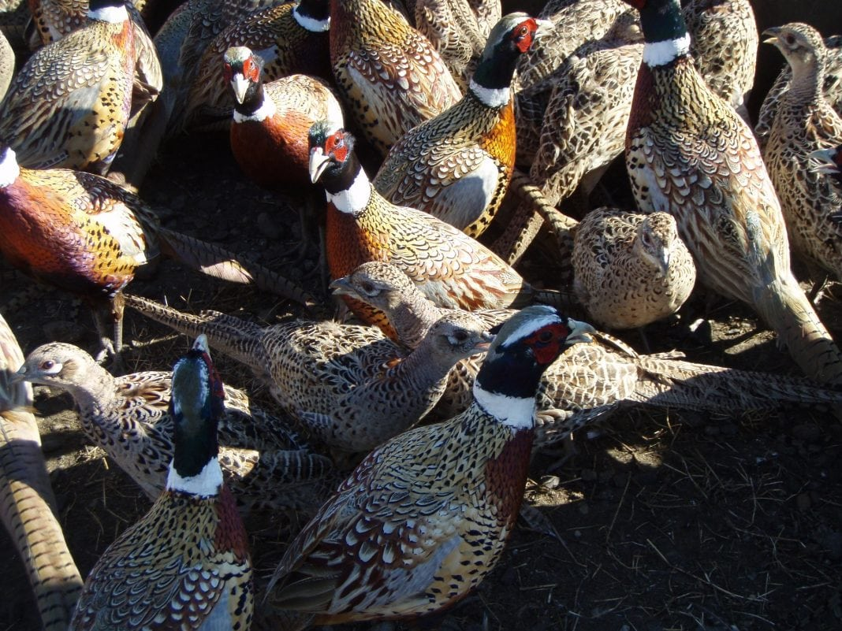
Conclusion
Obtained from Sam Denenberg
Game-farms encourage new hunters, encourages people to purchase hunting licenses and equipment
Raises money for wildlife conservation
Interbreeding between domestic and wild population is taking place in mallards
Released pheasants have low survival rates
There are fair chase issues when it comes to
pen-raised birds
Obtained from Bob Oak Game Farm

Slide 12
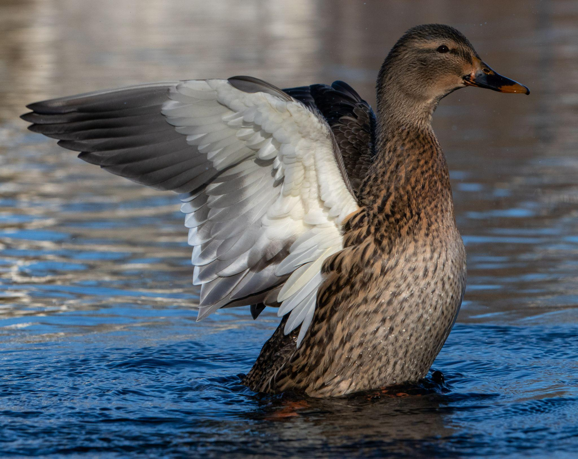
References
Are There Too Many Outfitters in Duck Hunting? | Outdoor Life. (n.d.). . https://www.outdoorlife.com/hunting/duck-hunting-outfitters-waterfowling/.
Cheng, K. M., R. N. Shoffner, R. E. Phillips, and F. B. Lee. 1980. Reproductive Performance in Wild and Game Farm Mallards. Poultry Science 59:1970–1976.
Don’t Fence Me In: Game Farms, Pro and Con. (n.d.). . https://www.ronspomeroutdoors.com/blog/dont-fence-me-in-game-farms-pro-and-con.
Eshelman, R. E. (n.d.). Historic Context Study of Waterfowl Hunting Camps and Related Properties within Assateague Island National Seashore, Maryland and Virginia:111.
Kearns, C. 2021, October 8. Field & Stream Won the Auction on John Oliver’s “Duck Hunt” Duck Stamp.Lavretsky, P., N. R. McInerney, J. E. Mohl, J. I. Brown, H. F. James, K. G. McCracken, and R. C. Fleischer. 2020. Assessing changes in genomic divergence following a century of human-mediated secondary contact among wild and captive-bred ducks. Molecular Ecology 29:578–595.
Mallards: A Dissolute Dabbler’s Rise and Decline - - The Adirondack Almanack. (n.d.). . https://www.adirondackalmanack.com/2018/07/mallards-a-dissolute-dabblers-rise-and-decline.html.
Musil, D. D., and J. W. Connelly. 2009. Survival and Reproduction of Pen-Reared vs Translocated Wild Pheasants Phasianus colchicus. Wildlife Biology 15:80–88.
NYS DEC. 2018. Hunting and Trapping Newsletter. (n.d.). . https://content.govdelivery.com/accounts/NYSDEC/bulletins/1fe0c50.
Paulson, M. 2014, October 24. Pheasant hunting in America: A brief history | Explore Big Sky.
Pheasant shooting - a short history. 2020, May 16. . https://gundog-journal.com/fieldsports/shoot/pheasant-shooting-a-short-history.
Schummer, M. (2022). Manky Mallards and Where to Find Them: The Conservation Paradox of Feral Populations and the Meaning of Wild [Google Slides]. file:///C:/Users/Alexis%20PC/AppData/Local/Microsoft/Windows/INetCache/Content.Outlook/XR61G22H/Manky%20Mallards%20and%20Where%20to%20Find%20Them.pdf
Schummer, M. (2022, November 30). Personal communication [Group Interview].
Soliman, M., M. M. Alfajaro, M.-H. Lee, Y.-J. Jeong, D.-S. Kim, K.-Y. Son, J. Kwon, J.-S. Choi, J.-S. Lim, J.-S. Choi, T.-U. Lee, K.-O. Cho, and M.-I. Kang. 2015. The prevalence of duck hepatitis A virus types 1 and 3 on Korean duck farms. Archives of Virology 160:493–498.
Philip Lavretsky. (n.d.).The Surprising Genetics of American Black Ducks and Mallards . https://www.ducks.org/conservation/waterfowl-research-science/the-surprising-genetics-of-american-black-ducks-and-mallards.
Obtained from Sam Denenberg

